Slide 1
Groß Schönebeck Dataset for DAS Bench
Yang Cui, SEEM group, King Fahd University of Petroleum and Minerals

Slide 2
Data Description

Slide 3
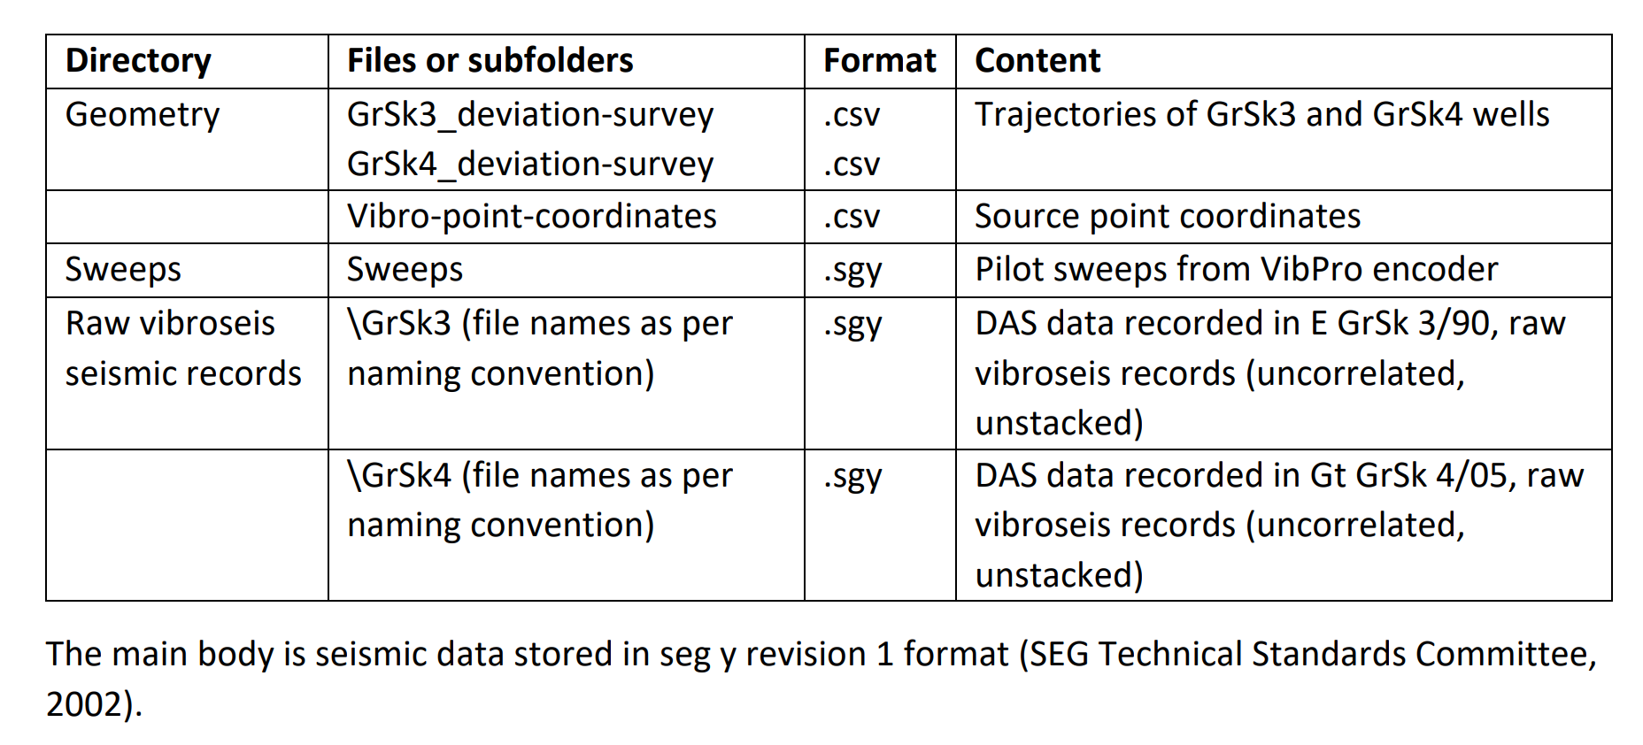
Index of /download/10.5880.GFZ.4.8.2022.014-Nvewifu
Groß Schönebeck dataset is an extensive vertical seismic profiling (VSP) survey using wireline distributed acoustic sensing (DAS) technology that was carried out between the 15th and 18th of February 2017 at the geothermal in-situ laboratory Groß Schönebeck, Germany. Borehole measurements were recorded in two 4.3 km deep wells E GrSk 3/90 and Gt GrSk 4/05. Two hybrid fibre optics cables were freely lowered inside the wells to form dense receiver arrays. As a seismic source, four heavy vibroseis trucks were used. The survey consisted of 61 source positions distributed in a spiral pattern around the target area. This data publication consists of raw uncorrelated, and unstacked seismic data acquired for 3D seismic imaging purposes. Supplementary information such as well trajectories, source point coordinates, and the pilot sweep data is also provided. (Henninges et al., 2021)
(Henninges et al., 2021)

Slide 4
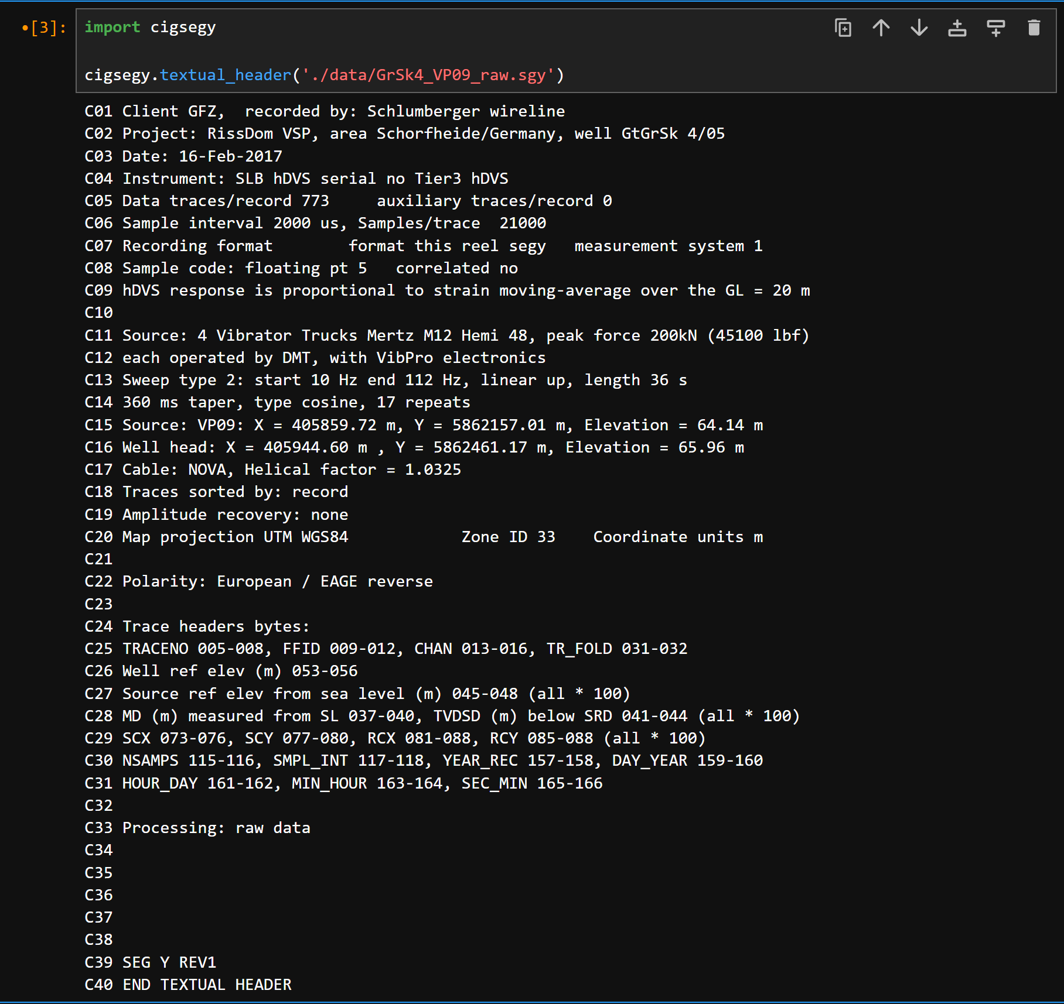
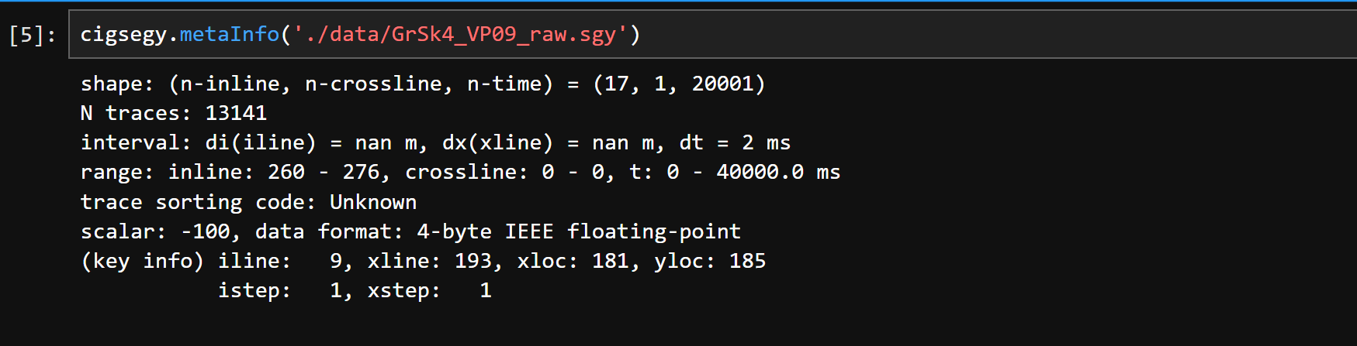

Slide 5
Preprocessing and Splitting

Slide 6
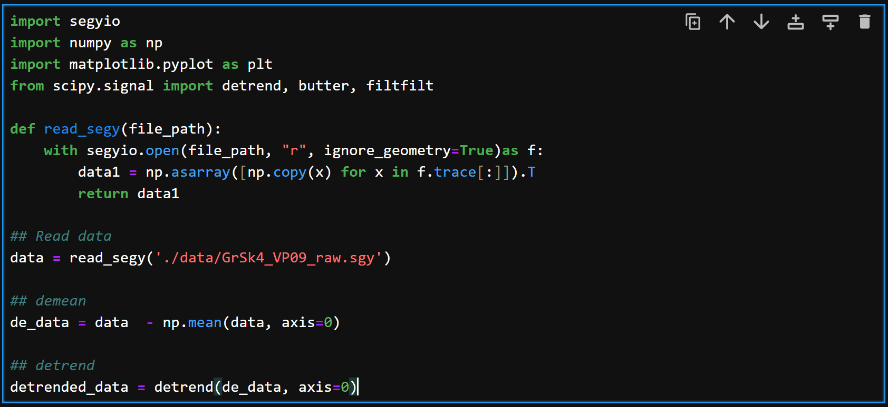
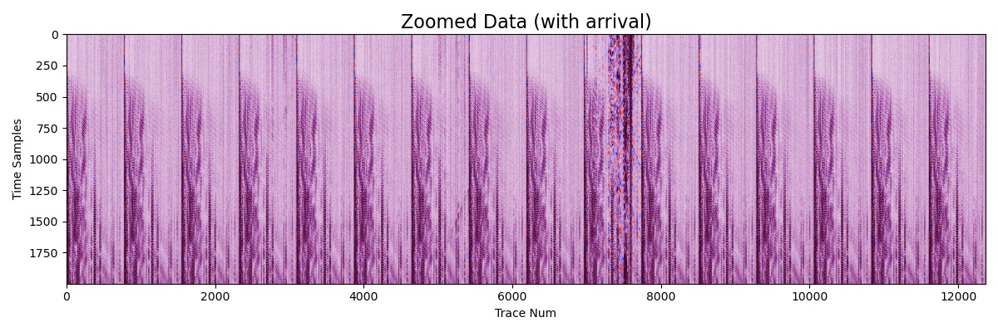
Step 1:
Run the “Get_data.sh” script to download the raw profiles. “bash Get_data.sh”
Step 2:
De-mean and De-trend using Scipy python library
Step 3:
Zoom in on profiles with only arrivals.

Slide 7
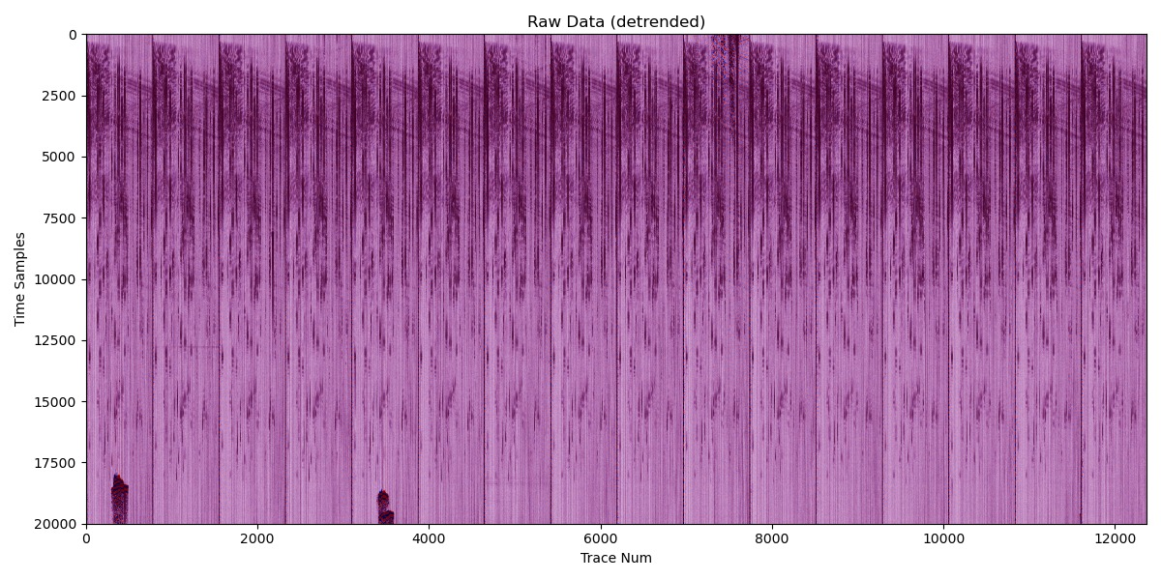
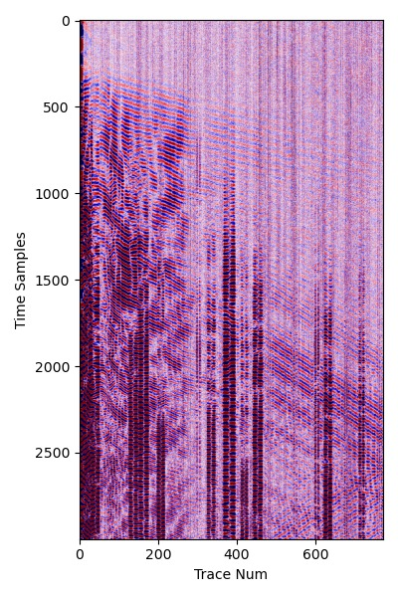
Step 4:
a)
c)
(20001, 13141)
b)
(2000, 700)
(2000, 13141)

Slide 8
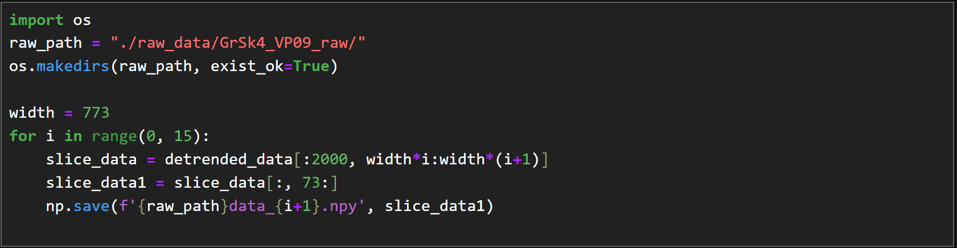
Step 5:
Split each zoomed section from the raw profiles into 15 samples and save them correspondingly

Slide 9
Processing with the DL models

Slide 10
After finishing the downloading, preprocessing, and splitting of the seismic data. You can perform the data processing workflow with the trained model used in our previous publication (Cui et al., 2025)
Step 1: Download the trained model in our previous publication
Step 2: Performing the processing using the given python script “USL_dataset_processing.ipynb”
Step 3: It takes around 3 seconds to process each samples

Slide 11
References
Henninges, J., Martuganova, E., Stiller, M., Norden, B., and Krawczyk, C. M.: DAS-VSP Data from the Feb. 2017 Survey at the Groß Schönebeck Site, Germany. [dataset], https://doi.org/10.5880/GFZ.4.8.2021.001, 2021a.
Henninges, J., Martuganova, E., Stiller, M., Norden, B., and Krawczyk, C. M.: Wireline distributed acoustic sensing allows 4.2 km deep vertical seismic profiling of the Rotliegend 150°C geothermal reservoir in the North German Basin, Solid Earth, 12, 521-537, https://doi.org/10.5194/se-12-521- 2021, 2021b.
Cui, Yang, Umair Bin Waheed, and Yangkang Chen. "Unsupervised Deep Learning for DAS-VSP Denoising Using Attention-Based Deep Image Prior." IEEE Transactions on Geoscience and Remote Sensing (2025).

